Slide 1
Physics 3 – Oct 22, 2019
Do Now: Mechanics Intuition Assessment (MIA) standardized test (30 min)
As a test of intuition, go with your gut, or your first choice. Don’t try to over think.
Notes:
Force Concept Inventory (FCI) called MIA for google search security access.

Slide 2
Objectives/Agenda/Assignment
Objective:
4.3 Wave characteristics
Agenda:
MIA Intuition Test
Homework Review
Wavefronts and rays
Superposition
Time for new assignment

Slide 3
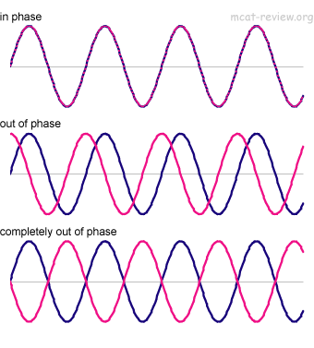
Phase
Because a waveform is a periodic occurrence, each point along the waveform corresponds to a degree from 0 to 360 that represents its location within the wave form, as the wave moves.
This degree measure is called a phase or phase angle.
Waves with the same phase angle are said to be in phase.
Waves with different phases angles are out of phase.
Waves that have phase angles that are 180 apart have opposite phases or are completely out of phase.

Slide 4
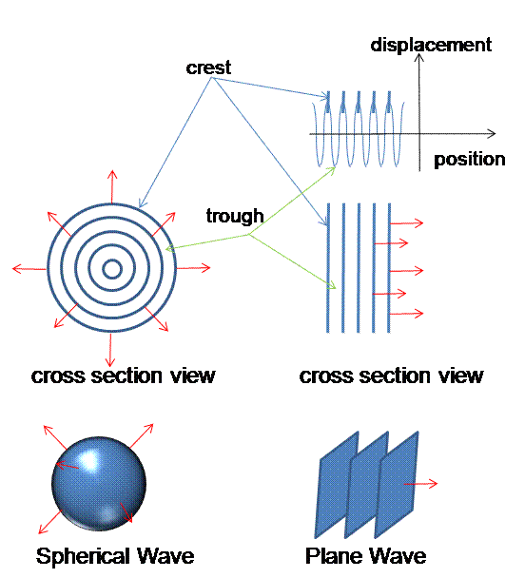
Wavefronts and Rays
A wavefront is the beginning of each cycle of the wave. All points on the wavefront are in phase. A ray is an arrow that indicates the direction of propagation for the wave. Rays are always perpendicular to wavefronts.
For a 1D wave along a string, wavefront is a perpendicular line through the peaks.
For a 2D wave from a point source, the wavefront forms a circle.
For a 3D wave from a point source the wavefront forms a sphere
For an extended source you can create wavefronts that are parallel planes

Slide 5
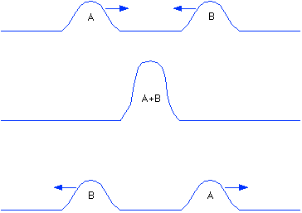
Superposition
Principle of superposition: When two waves are present on the same medium, the resulting motion of the particles of the medium is the sum of the two wave displacements.
Consider two waves passing each other going is opposite directions.
When the two waves have opposite phase, they cancel each other out in destructive interference.
When two waves are in phase, they add together and have constructive interference.

Slide 6
Sample problem
Sketch how these two waves interact as they pass one another at a) the moment they first meet, b) when they are a ¼ way, c) ½ way d) ¾ way and e) all the way past each other.

Slide 7
Practice problem
Sketch how these two waves interact as they pass one another at a) the moment they first meet, b) when they are a ¼ way, c) ½ way d) ¾ way and e) all the way past each other.
Do on whiteboards.

Slide 8
Exit slip and homework
Exit Slip – When will the result of two waves interacting on a string result in no displacement of the medium? Explain how this can be applied to noise canceling headphones.
What’s due? (homework for a homework check next class)
p171 #15-18
What’s next? (What to read to prepare for the next class.
Read IB 4.3, p162-170

